Slide 2
Problem Statement
In the digital age, images are extensively used for various purposes such as social media, digital art, medical imaging, and surveillance. However, low-resolution or pixelated images can significantly hinder the extraction of valuable information. Pixelation often results from compression, scaling, or poor-quality capturing devices. Correcting pixelated images to improve their clarity and resolution is essential for accurate analysis and presentation.
The objective of this project is to develop a machine learning model that detects and corrects pixelated images, enhancing their quality and making them suitable for practical applications. The model will be trained on a diverse dataset containing both high-resolution and pixelated images.

Slide 3
SOLUTION
To develop a machine learning model for correcting pixelated images:
Steps:
1. Data Collection: Gather high-resolution and pixelated images; create pixelated versions of high-res images.
2. Model Selection: Choose super-resolution models like SRCNN, FSRCNN, ESPCN, or SRGAN.
3. Model Training: Train using high-res images as ground truth and pixelated images as input. Use MSE and perceptual loss functions.
4. Evaluation: Assess using PSNR and SSIM metrics; test on a separate dataset.
5. Fine-Tuning: Optimize hyperparameters and refine the model.
6. Deployment: Implement in applications with a user-friendly interface for real-time image enhancement.
This approach will enhance pixelated images for practical use.

Slide 4
FEATURES OFFERED
1. Image Enhancement
- Pixelation Detection: Automatically identify and target pixelated regions in images.
- Quality Improvement: Convert low-resolution, pixelated images into high-resolution, clear images.
2. Model Efficiency:
- Real-Time Processing: Capable of enhancing images quickly for real-time applications.
- Adaptive Enhancement: Adjusts to different levels of pixelation for optimal results.
3. User-Friendly Interface:
- Easy Upload: Simple interface for users to upload and enhance images.
- Preview and Save: Allows users to preview enhanced images and save them in various formats.
4. Robustness and Flexibility:
- Wide Application: Suitable for social media, digital art, medical imaging, and surveillance.
- Scalability: Can be integrated into different platforms and scaled for large datasets.
5. Advanced Metrics:
- Quality Metrics: Uses PSNR and SSIM to ensure high-quality image output.
- Performance Monitoring: Continuous evaluation and improvement based on user feedback and new data.
These features ensure the model effectively enhances pixelated images, making them suitable for various practical applications

Slide 5
PROCESS FLOW
1. **Data Collection**:
- **Gathering Data**: Collect high-resolution and pixelated images.
- **Creating Pixelated Versions**: Downsample and upsample high-resolution images to generate pixelated versions.
2. **Data Preprocessing**:
- **Normalization**: Normalize images for consistent input.
- **Augmentation**: Apply data augmentation techniques to increase dataset diversity.
3. **Model Selection**:
- **Choosing Architecture**: Select appropriate super-resolution models (SRCNN, FSRCNN, ESPCN, SRGAN).
4. **Model Training**:
- **Input-Output Pairing**: Train models using pixelated images as input and high-resolution images as ground truth.
- **Loss Functions**: Use MSE and perceptual loss functions to guide training.
5. **Model Evaluation**:
- **Testing**: Test model on a separate dataset.

Slide 6
- **Metrics**: Evaluate performance using PSNR and SSIM. 6. **Fine-Tuning**: - **Hyperparameter Tuning**: Optimize learning rate, batch size, and network architecture. - **Iterative Improvement**: Refine model based on evaluation results. 7. **Deployment**: - **Integration**: Deploy the model in target applications. - **User Interface**: Develop a user-friendly interface for image upload, enhancement, preview, and download. 8. **Post-Deployment**: - **Monitoring**: Continuously monitor model performance and gather user feedback. - **Updates**: Regularly update the model with new data and improvements. This process flow ensures systematic development and deployment of the machine learning model for correcting pixelated images

Slide 7
ARCHITECTURE DIAGRAM

Slide 8
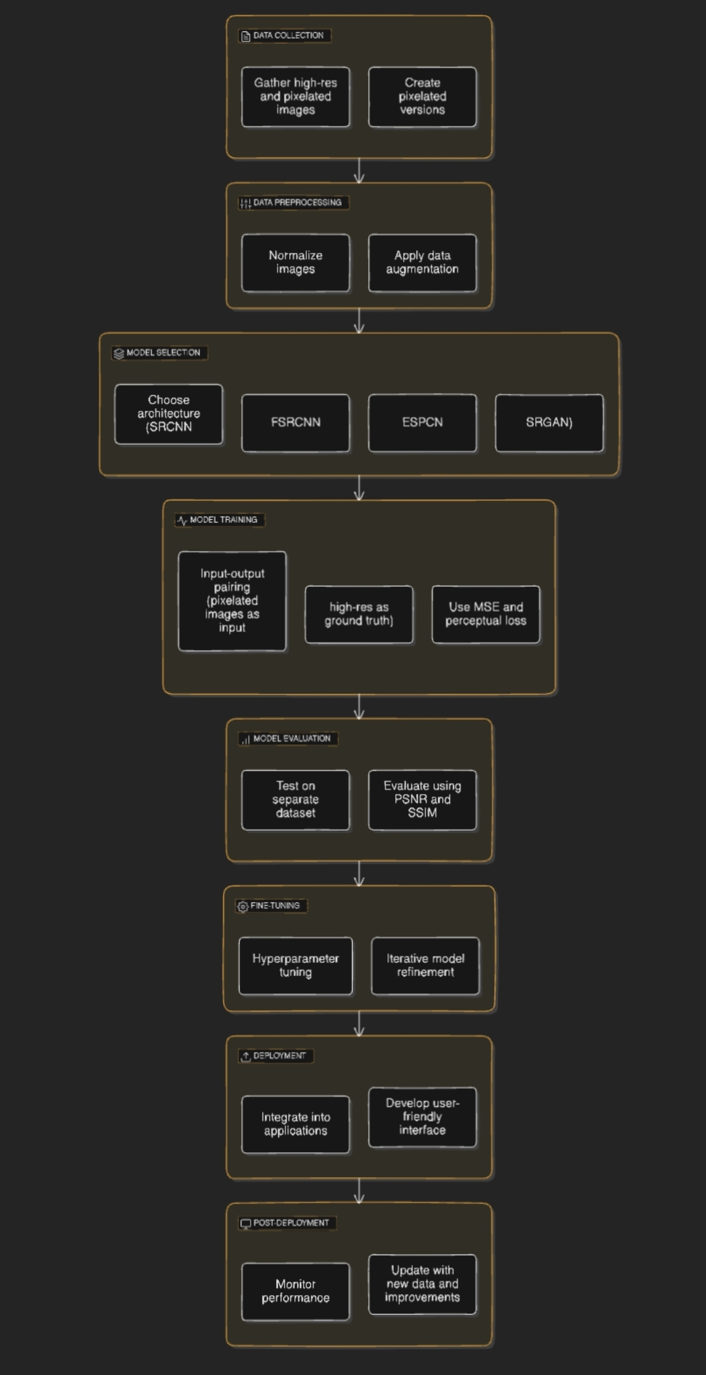

Slide 9
TECHNOLOGY USED
1. **Data Collection & Preprocessing**:
- **Python**: For scripting and data handling.
- **Libraries**: OpenCV, PIL (Python Imaging Library) for image processing; NumPy for numerical operations.
- **Data Augmentation**: Libraries like Augmentor or imgaug for creating variations in the dataset.
2. **Model Development**:
- **Deep Learning Frameworks**:
- **TensorFlow**: For building and training neural networks.
- **PyTorch**: Another option for developing and training models.
- **Model Architectures**: Implementation of SRCNN, FSRCNN, ESPCN, or SRGAN models.
- **GPU Acceleration**: Utilizing NVIDIA CUDA and cuDNN for faster training on GPUs.
3. **Model Training & Evaluation**:
- **Training Environment**:
- Cloud platforms like Google Colab, AWS EC2, or Azure for scalable and powerful computation resources.
- **Loss Functions**: Implementation of MSE and perceptual loss functions using deep learning libraries.
- **Evaluation Metrics**: Using PSNR and SSIM libraries in Python for quality assessment.
4. **Fine-Tuning**:
- **Hyperparameter Optimization**: Tools like Optuna or Hyperopt for automated tuning.
- **Model Checkpointing**: Libraries like TensorFlow’s ModelCheckpoint or PyTorch’s checkpointing for saving the best models during training.

Slide 10
5. **Deployment**:
- **Model Serving**:
- **TensorFlow Serving** or **TorchServe** for serving models in production.
- **FastAPI** or **Flask** for creating RESTful APIs.
- **Containerization**: Docker for packaging the model and its dependencies.
- **Orchestration**: Kubernetes for managing containerized applications at scale.
6. **User Interface**:
- **Frontend Technologies**:
- **HTML**for building the user interface.
- **React.js** or **Vue.js** for creating dynamic and responsive web applications.
- **File Handling**: Libraries like Dropzone.js for image upload functionality.
7. **Post-Deployment**:
- **Monitoring**: Tools like Prometheus and Grafana for monitoring performance and system health.
- **Continuous Integration/Continuous Deployment (CI/CD)**: Jenkins, GitHub Actions, or GitLab CI for automated testing and deployment.
These technologies provide a comprehensive toolkit for developing, training, deploying, and maintaining a machine learning model for correcting pixelated images.

Slide 11
TEAM
ADITHYAN E

Slide 12
CONCLUSION
Developing a machine learning model to correct pixelated images involves a systematic process, leveraging modern technologies and techniques. By collecting and preprocessing a diverse dataset, selecting and training appropriate super-resolution models, and fine-tuning the model for optimal performance, we can achieve significant enhancements in image quality. Deploying the model with a user-friendly interface allows for real-time image enhancement across various applications, including social media, digital art, medical imaging, and surveillance. Continuous monitoring and updating ensure the model remains effective and up-to-date with the latest advancements. This approach not only improves image clarity but also enhances the extraction of valuable information from images, making them suitable for practical and critical applications.

